Slide 1


MUSICAL INSTRUMENT IDENTIFICATION BY USING AUDIO FEATURES
Mid-Review 3
Major Project
Project ID: A2
AY 2021-25
GITAM (Deemed-to-be) University
Project Team:
P.Uday kumar raju
C.Rama Karthik
S.Venkata Siva kumar
Department of Electrical Electronics and Communication Engineering
Project Mentor
Dr.Chintoo Kumar sir
www.gitam.edu

Slide 2
Objective and Goals
Objective
Lots of Musical content are uploaded on social media daily. It is time-consuming to search content according to our choice. Musical information retrieval is one of the evolving research fields which deals with retrieving content from audio data. Musical instrument recognition is subdomain of musical information retrieval. Previous research work had mostly focused on various western instruments belonging to distinct families, such as brass, string and woodwind are classified. The purpose of this study is to classify musical instruments using audio Features with Integrated Entropy method. Monophonic recordings of solo instrument artists are used in the experiments. Audio features have taken into account temporal, spectral, the first 13 Mel-frequency Cepstral Coefficients (MFCC) and Gammatone Frequency Cepstral Coefficients(GFCC). The proposed method generates a vector that integrates entropy with extracted features. Musical instruments are classified using generated vector. For classification, a Support Vector Machine (SVM) has been used.
Goals
Main Goals
Develop a Classification Model
Dataset Collection and Preprocessing
Training and Testing the Model
Real-Time Instrument Identification
Application Development

Slide 3
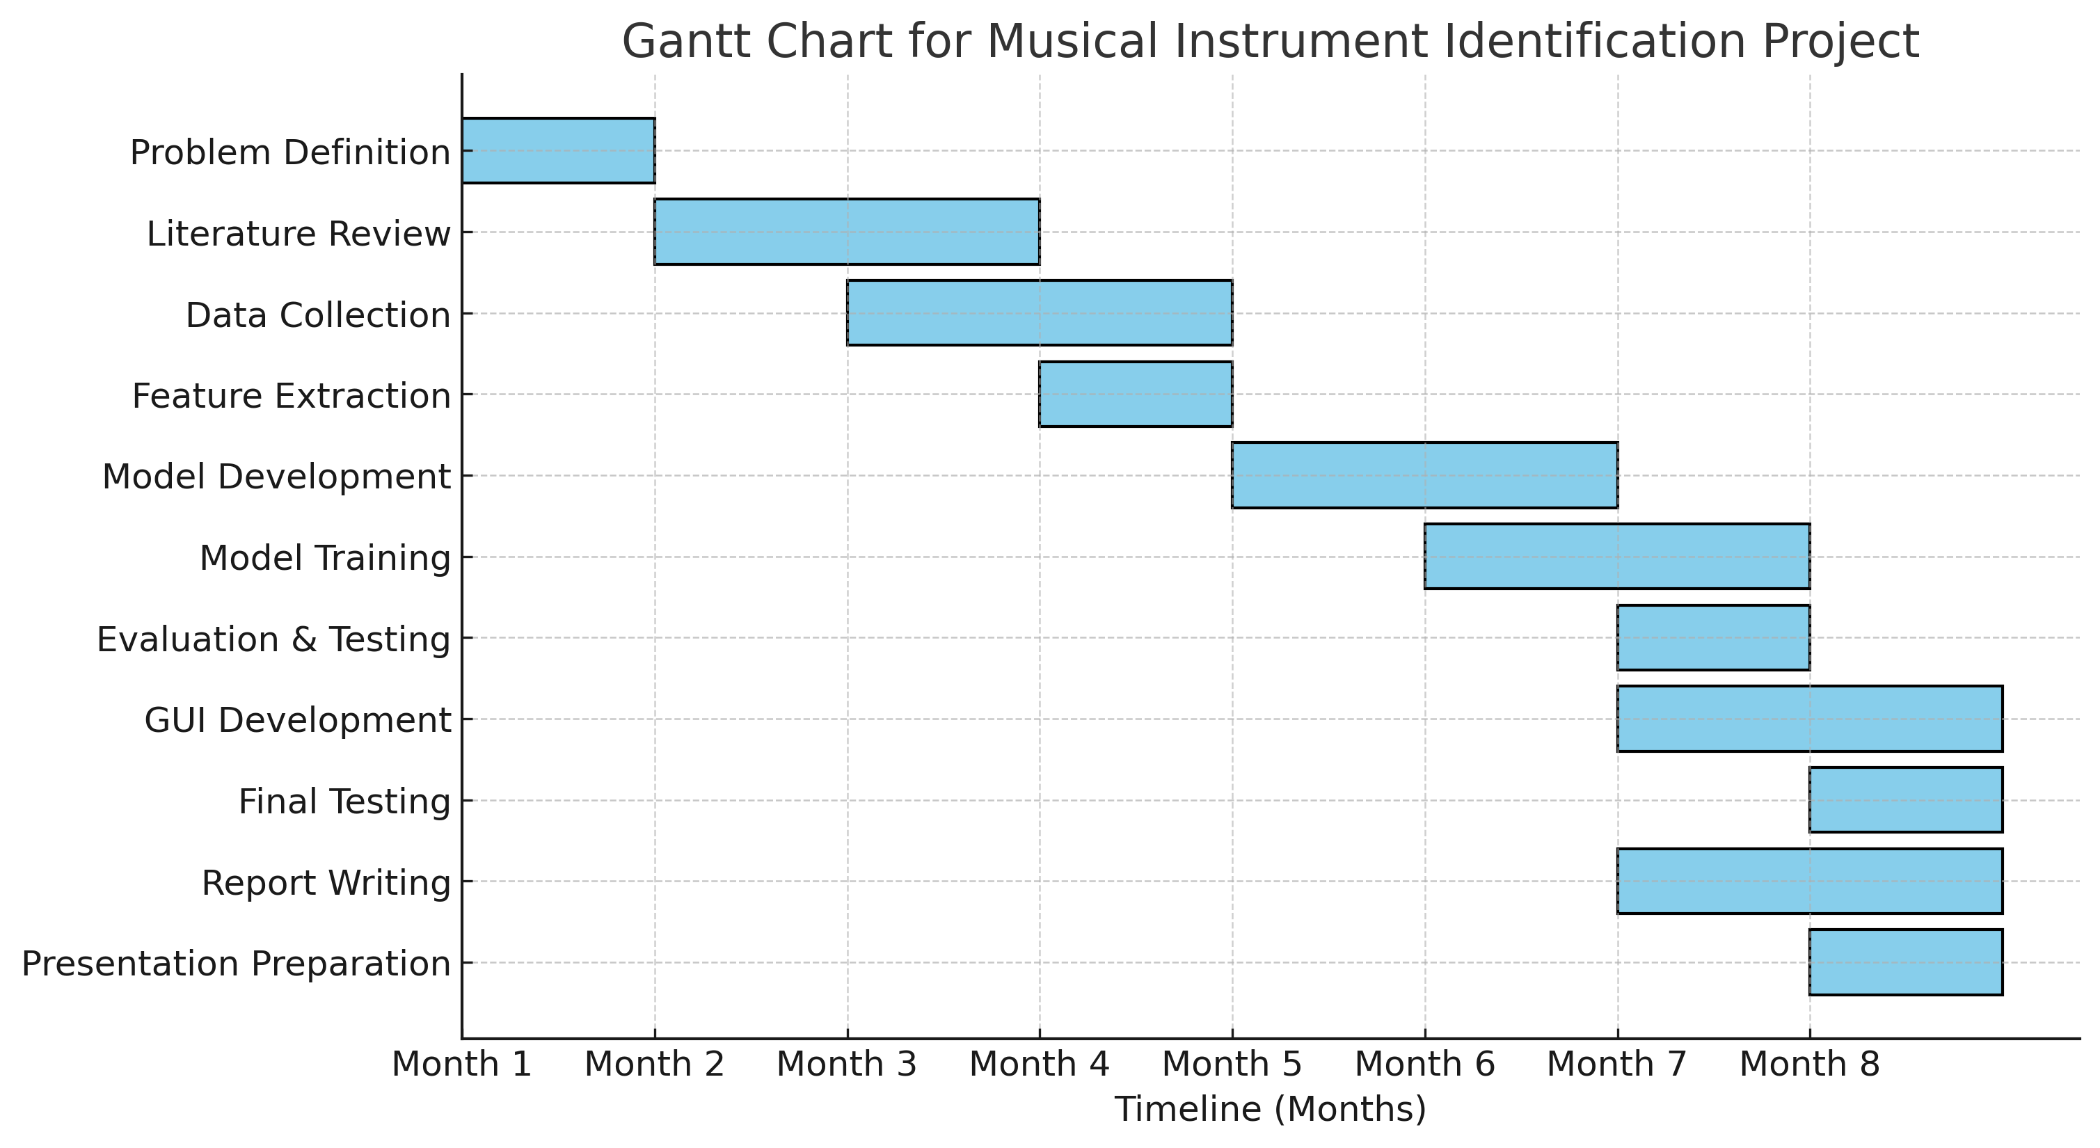
Project Plan (Clearly mention milestone for objectives under each reviews)

Slide 4
Literature Survey (Improved post minor project)
Key Publications
Musical Instrument Identification Using Timbre Models
Authors: Essid, S., Richard, G., and David, B.
Journal: IEEE Transactions on Audio, Speech, and Language Processing, 2006.
2. Automatic Musical Instrument Recognition in Polyphonic Music
Authors: Benetos, E., Cherla, S., and Dixon,
S.Conference: IEEE International Conference on Acoustics, Speech, and Signal Processing (ICASSP), 2013.
Key Resources – Whitepaper| Application Notes | Datasheet| Others
https://ieeexplore.ieee.org/document/1021072
https://www.academia.edu/21858073/Musical_Instrument_Recognition_in_Polyphonic_Audio_Using_Missing_Feature_Approach
https://arxiv.org/pdf/1605.09507
Existing Implementations – Products| Opensource| GitHub etc
Datasets for Musical Instrument Classification
IRMAS Dataset: The Instrument Recognition in Musical Audio Signals dataset, which contains recordings of polyphonic music (solo and mixed) for instrument classification.

Slide 5
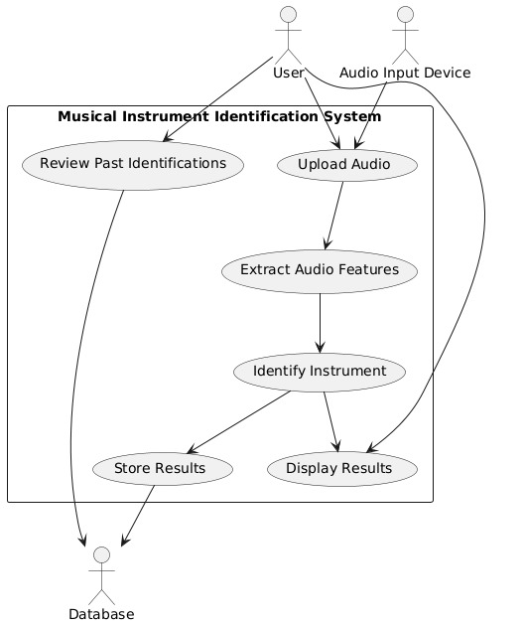
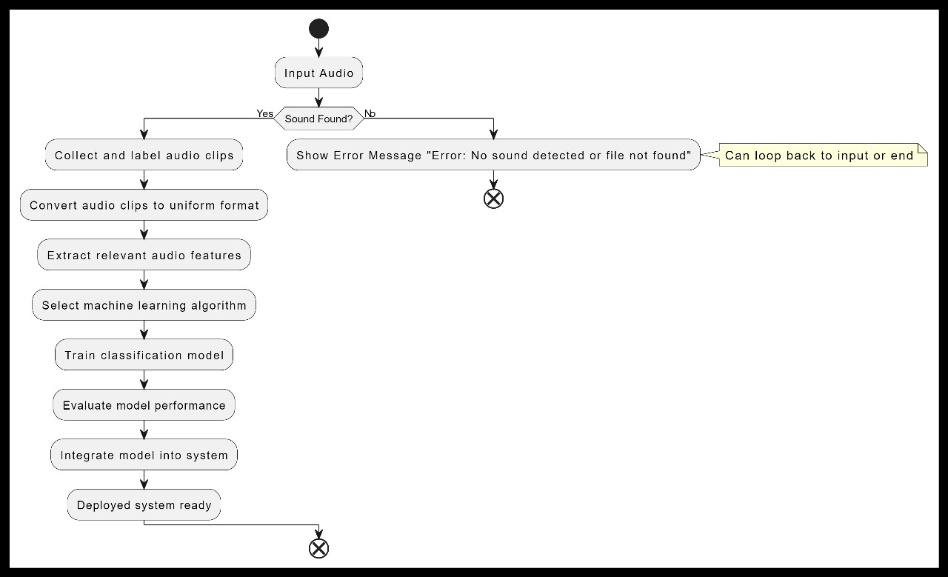
Architecture
Structural Diagram:
Behavioural Diagram:

Slide 6
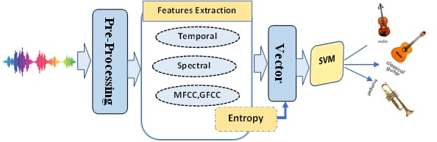

Slide 7
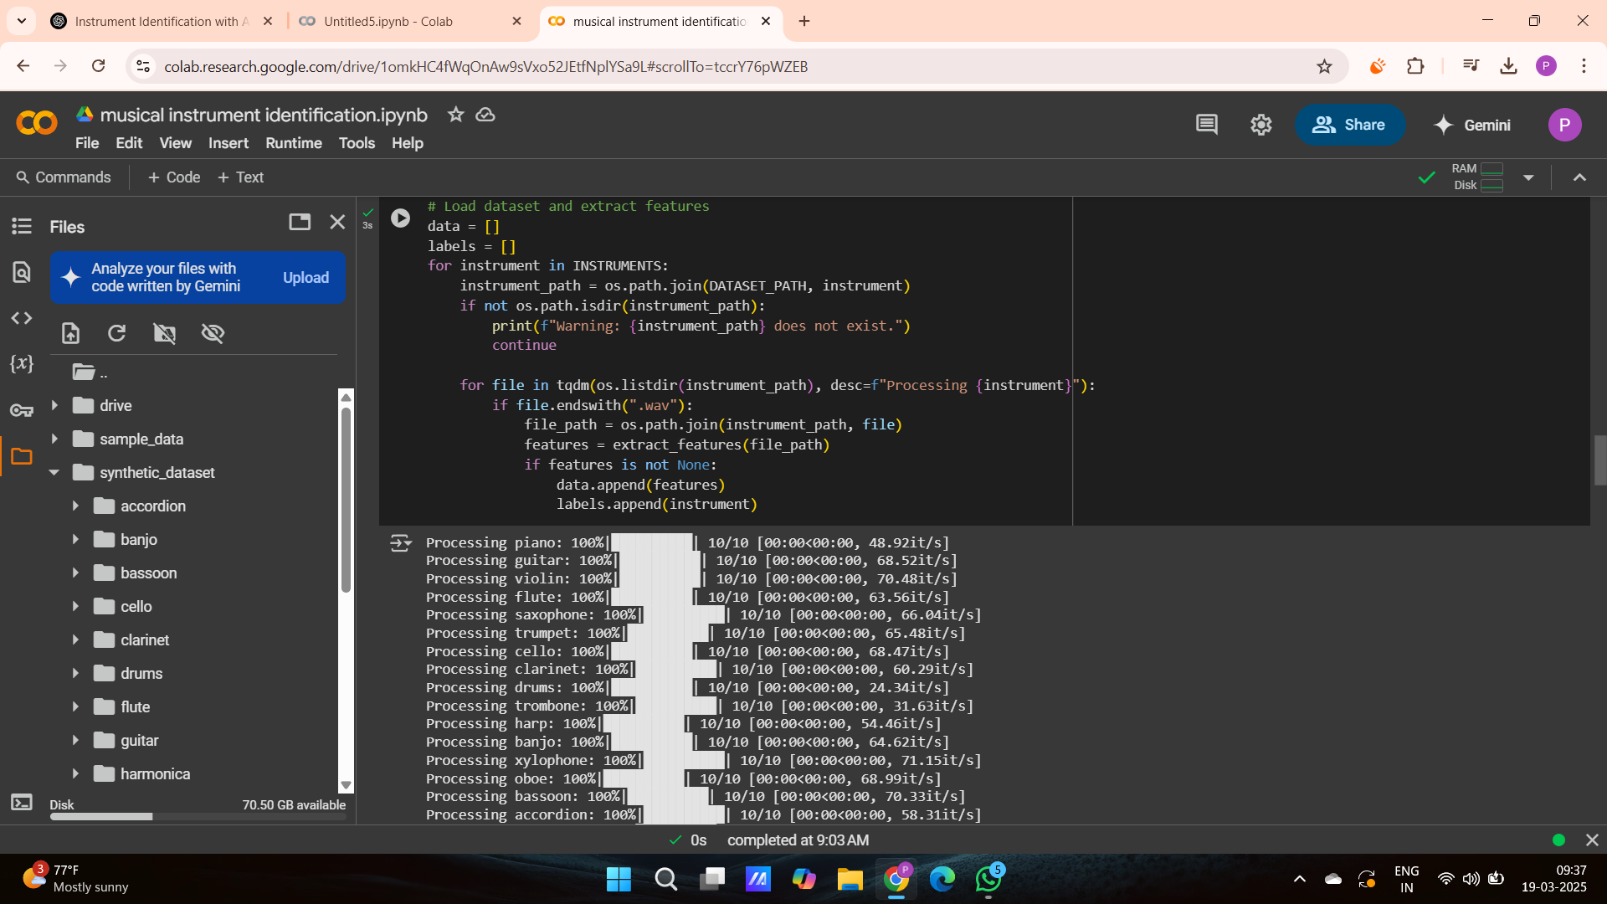
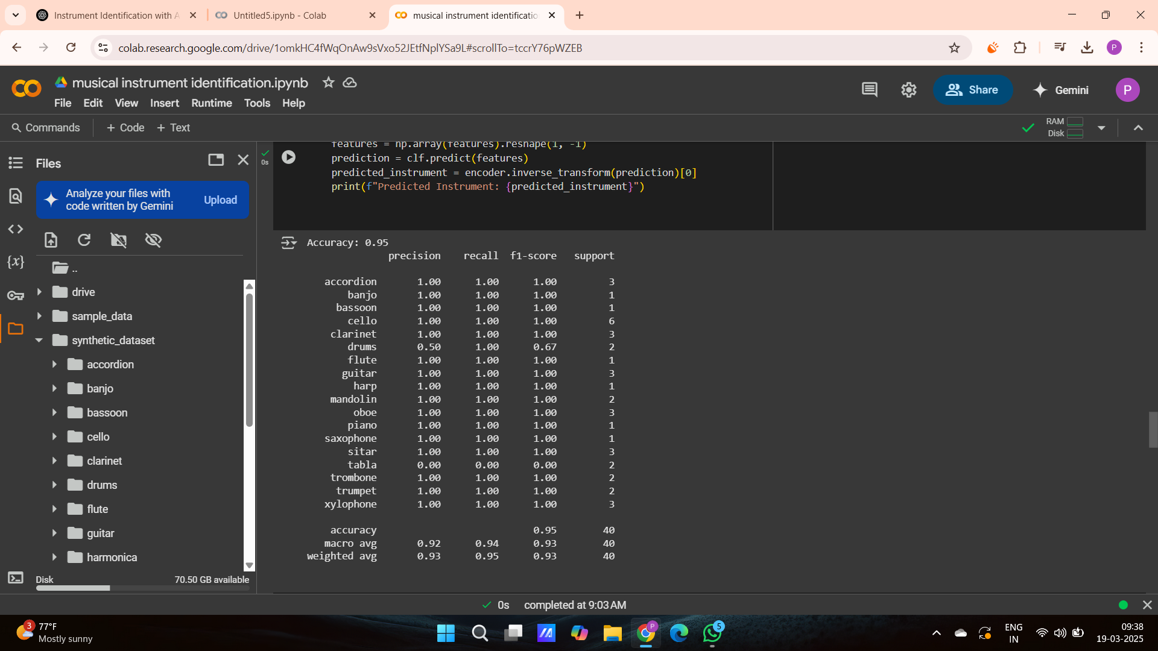
OUTPUTS & RESULTS:

Slide 8
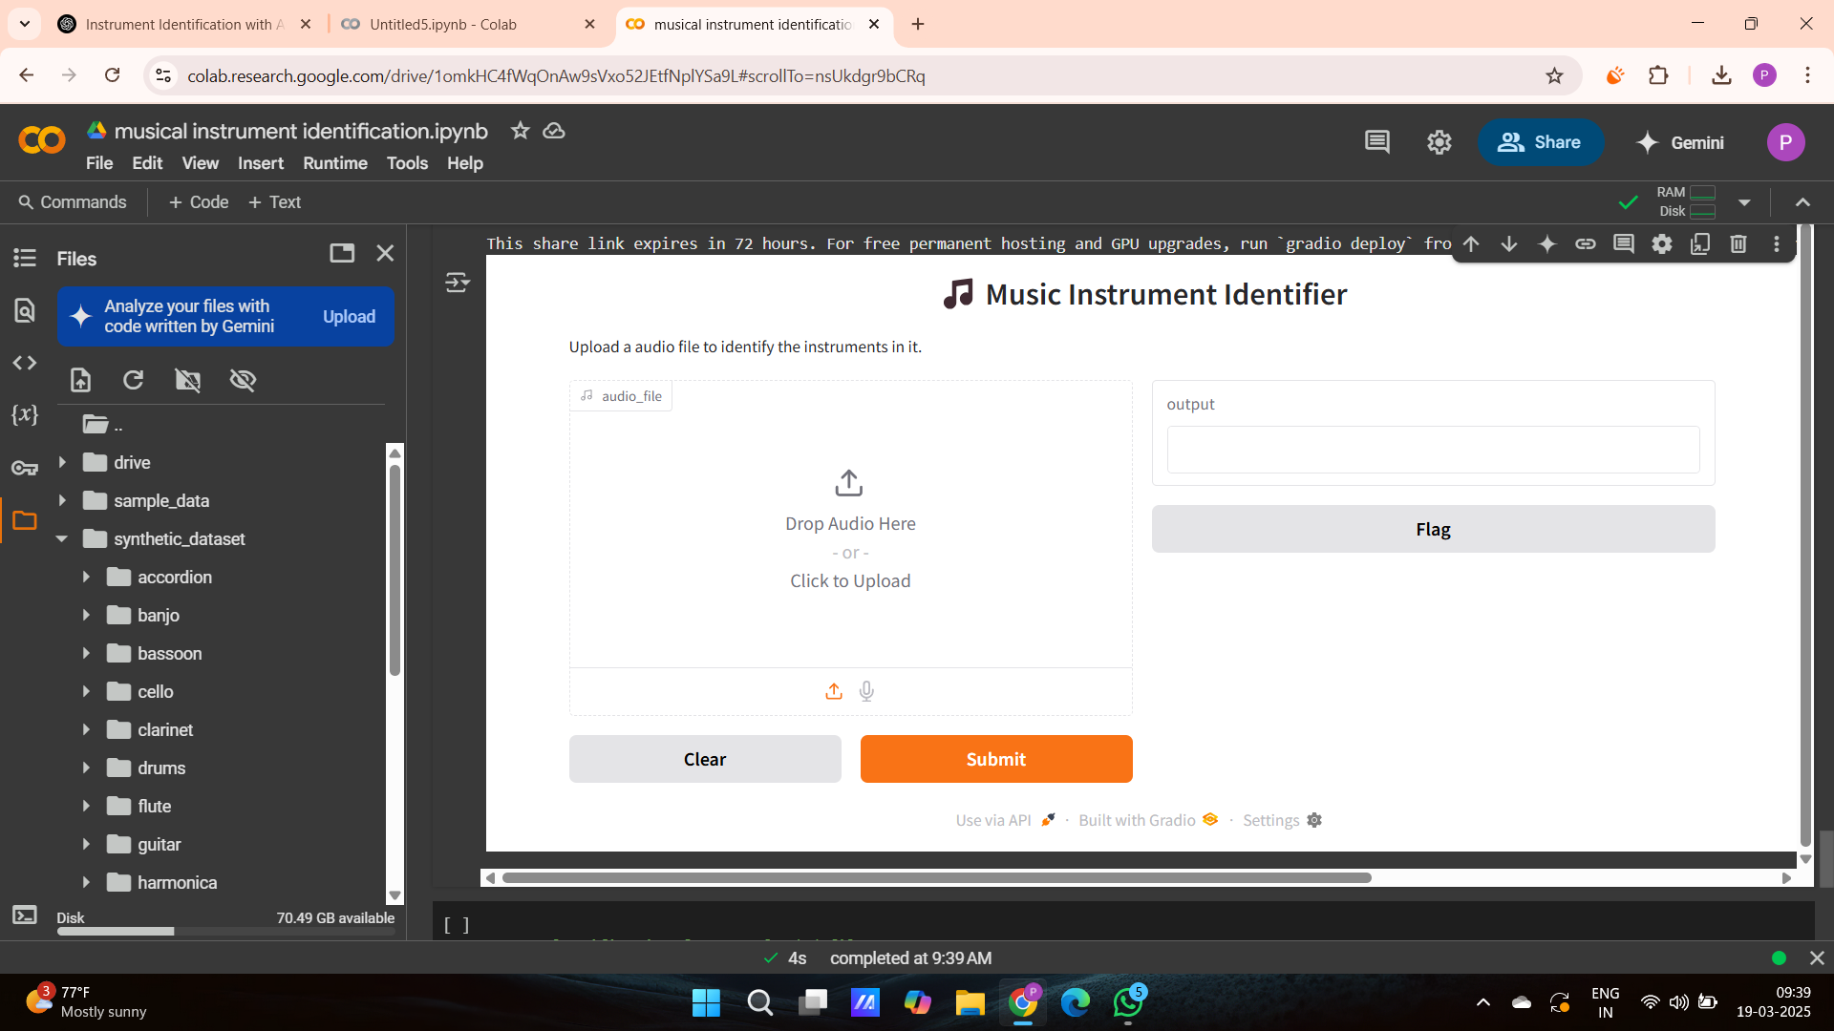
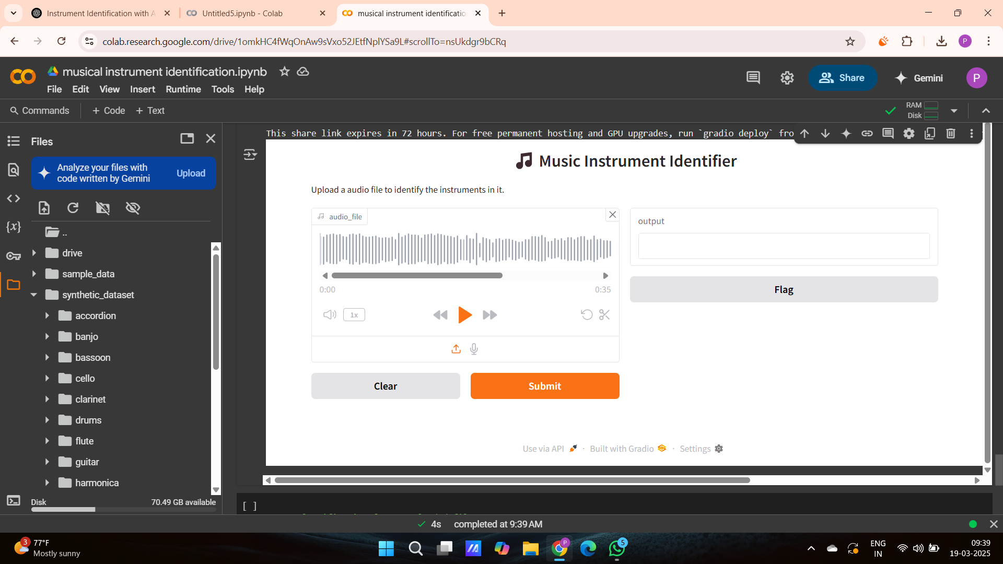
OUTPUTS & RESULTS:

Slide 9


Slide 10
THANK YOU
Have a Great Day !

